Slide 1
Selection and Repetition Control Structure, Pseudocode Algorithms Using Sequence, Selection and Repetition
Session 05
(Tutorial)
Course : Program Design Methods
Effective Period : July 2018

Slide 2
These slides have been adapted from
Simple Program Design : A Step by step approach., Lesley Anne Robertson, Fifth Edition,
Course Technology. ISBN: 978-1-4239-0132-7. Chapter 4 - 6
Acknowledgement

Slide 3
LO 2 : Apply the process of program developing
LO 3 : Design the application using program design method
Learning Objectives

Slide 4
Contents
The Selection Control Structure
Algorithm using Selection
The Case Structure
Repetition using the DO-WHILE Structure
Repetition using the REPEAT ...UNTIL Structure
Counted Repetition
Solution Algorithms
Flowchart

Slide 5
The Selection Control Structure

Slide 6
The Selection Control Structure
The selection control structure represents the decision – making abilities of a computer
The condition in the IF statement is based on comparison of two items, and is usually expressed with on of the following relational operators :
< less than
> greater than
= equal to
<= less than or equal to
>= greater than or equal to
<> not equal to

Slide 7
Variations of the Selection Structure
Simple selection (Simple IF Statement)
Simple selection with null false branch (null ELSE statement)
Combined selection (combined IF statement)
Nested selection (nested IF statemen)

Slide 8
Algorithm using Selection

Slide 9
Algorithm using Selection
Case: Design an algorithm that will prompt a terminal operator for three characters, accept those characters as input, sort them into ascending sequence and output them to the screen
Solution:
  A. Defining Diagram
Input | Processing | Output
char_1 char_2 char_3 | Prompt for characters Accept three characters Sort three characters Output three characters | char_1 char_2 char_3

Slide 10
Example (cont’d)
B. Solution Algorithm
The solution algorithm requires a series of IF statements to sort the three characters into ascending sequence
Read_three_characters
1 Prompt the operator for char_1, char_2, char_3
2 Get char_1, char_2, char_3
3 IF char_1>char_2 THEN
temp = char_1
char_1 = char_2
char_2 = temp
ENDIF
4 IF char_2>char_3 THEN
temp = char_2
char_2 = char_3
char_3 = temp
ENDIF
5 IF char_1>char_2 THEN
temp = char_1
char_1 = char_2
char_2 = temp
ENDIF
6 Output to the screen char_1, char_2, char_3
END

Slide 11
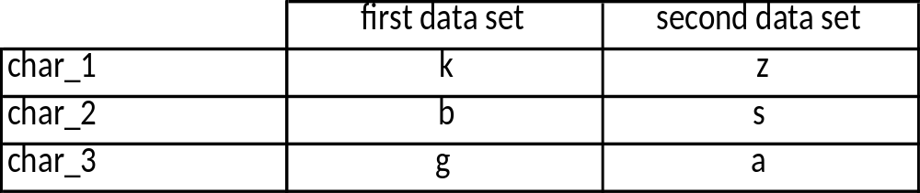
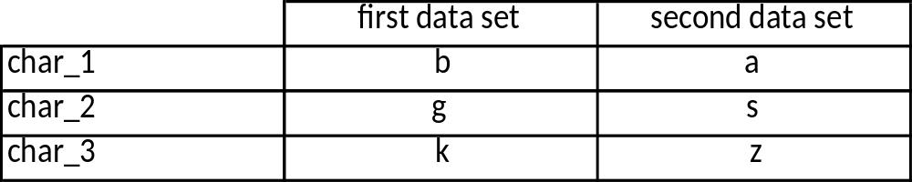
Example (cont’d)
C. Desk Checking
Two sets of valid characters will be used to check the algorithm; the characters k ,b , and g as the first and z, s, and a as the second
  Input data
  2. Expected result

Slide 12
Example (cont’d)
  3. Desk check table
  Line numbers have been used to identify each statement within the program. Note that when desk checking the logic each IF statement is treated as a single statement .

Slide 13
The Case Structure

Slide 14
The case structure
The case control structure in pseudocode is another way of expressing a linear nested IF statement
Example :
CASE OF tax_code
0 : sales_tax = 0
1 : sales_tax = purch_amt * 0.03
2 : sales_tax = purch_amt * 0.05
3 : sales_tax = purch_amt * 0.07
ENDCASE

Slide 15
Repetition using the dowhile Structure

Slide 16
Repetition
There are three different ways in which a set of instructions can be repeated, and each way is determine by where the decision to repeat is placed :
  At the beginning of the loop (leading decision loop)
  At the end of the loop (trailing decision loop)
  A counted number of times (counted loop)

Slide 17
DOWHILE
The DOWHILE construct is a leading decision loop which means the condition is tested before any statements are executed.
DOWHILE Format :
DOWHILE condition p is true
statement block
ENDDO
The following processing takes place :
  The logical condition p is tested
  If condition p is found to be true, the statements within the statement block are executed once. The delimiter ENDDO then triggers a return of control to the retesting of condition p
  If condition p is still true, the statements are executed again, and so the repetition process continues until the condition is found to be false
  If condition p is found to be false, control passes to the next statement after the deliminiter ENDDO and no further processing takes place within the loop

Slide 18
DOWHILE
Consideration before designing a DOWHILE loop :
  The testing of condition is at the beginning of the loop. Meaning that it may be necessary to perform some initial processing before it can be tested
  The only way to terminate the loop is to render DOWHILE condition false

Slide 19
DOWHILE
Using DOWHILE to repeat a set of instructions an unknown number of times
  When a trailer record or sentinel exists
    The sentinel is a special record or value placed at the end of valid data to signify the end of the data
  When a trailer record or sentinel does not exists
    When there is no trailer record or sentinel to signify the end of the data, it is necessary to check for an end-of-file marker (EOF). The following expressions can be used :
      DOWHILE more data
      DOWHILE more records
      DOWHILE records exist
      DOWHILE NOT EOF

Slide 20
Repetition using the Repeat . . . Until Structure

Slide 21
REPEAT . . . UNTIL
a REPEAT . . . UNTIL structure test the condition at the end of the loop. Meaning that the statements within the loop will be executed once before the condition is tested.
The format
REPEAT
statement
statement
….
UNTIL

Slide 22
Counted Repetition

Slide 23
Counted repetition
Counted repetition occurs when the exact number of loop iteration is known in advance
The execution of the loop is controlled by a loop index, as follow
DO loop_index = initial_value to final_value
statement block
ENDDO
The DO loop does more than repeat the statement block. It will :
  Initialise the loop_index to the required initial_value
  Increment the loop_index by 1 for each pass through the loop
  test the value of loop_index at the beginning of each loop to ensure that it is within the stated range of values
  Terminate the loop when the loop_index has exceeded the specified final_value

Slide 24
Solution Algorithm

Slide 25
Solution Algorithms
Each solution will be consist of :
  Defining the problem
  The control structures required
  The solution algorithm
  Desk checking

Slide 26
Flowchart
Flowchart is an alternative method of representing algorithms

Slide 27
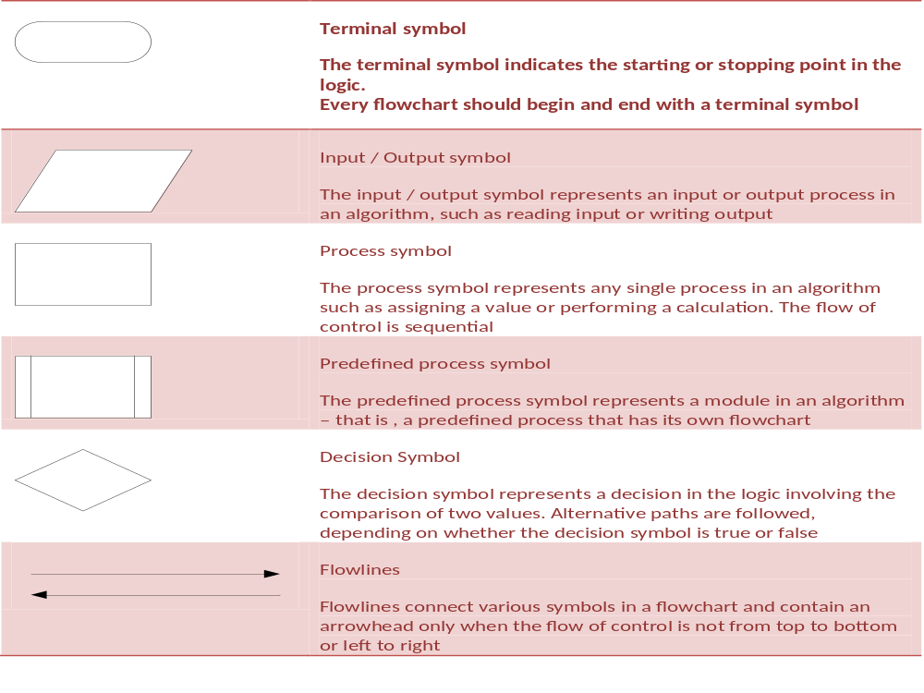

Slide 28
References
Simple Program Design : A Step by step approach., Lesley Anne Robertson, Fifth Edition,
Course Technology. ISBN: 978-1-4239-0132-7.
Selection structure, http://www.thevbprogrammer.com/Ch05/05-03-SelectionStructure.htm
Getting Control, http://aelinik.free.fr/c/ch10.htm/05-03-SelectionStructure.htm
Repetition Structure, http://www.thevbprogrammer.com/Ch05/05-04-RepetitionStructure.htm

Slide 29
Q & A

